Slide 1
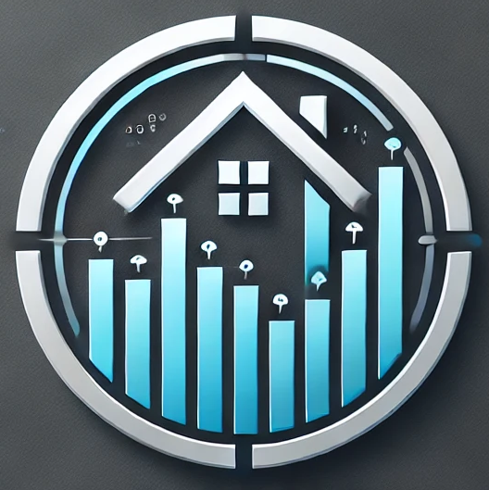
Real Estate Automated Valuation
Model
Jeremy Wizenfeld, Aaron Poulad, and Yair Levie

Slide 2
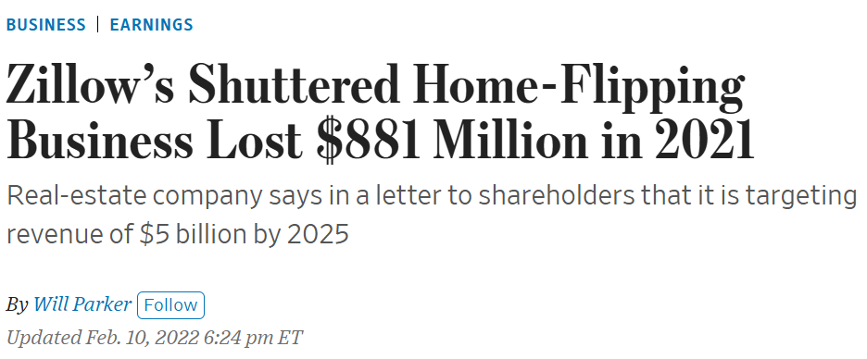
Problem:
Given the rapid pace of real estate markets, manually evaluating numerous properties can be time-consuming and inefficient.
iBuying- a company makes an offer to buy a home without going out to visit it
Successful in generic houses of similar quality and size, but less effective for high-end or low-quality homes where construction quality significantly impacts pricing.
Zillow’s Shuttered Home-Flipping Business Lost $881 Million in 2021
Notes:
Real estate investors rely on accurate pricing predictions to make informed decisions about property investments. These predictions typically require analyzing structured data like property size, location, and comparable sales (comps), as well as visual data such as property images. Given the rapid pace of real estate markets, manually evaluating numerous properties can be time-consuming and inefficient.

Slide 3
Solution:
Examine property images to refine price prediction
Allows us to account for building quality, not seen in standard property data
Convolutional Neural Network (CNN) approach
Use a CNN to categorize room types and score key visual features such as property condition, style, and quality from specific rooms
Score refinement
Consolidate multiple image scores into an overall property quality score, and combine with structured data to attain a more accurate property value estimate

Slide 4
Project Timeline
Q1:
August 28th- September 25th
Q2:
September 26th- October 14th
Q3:
October 15th- November 20th
Q4:
November 21st- December 11th
1. Researched CNNs
2. Researched Regression Models
3. Devised a plan for data collection
1. Deployed Label System on GCP to Collect and Clean Data
2. Developed basic Linear Regression models
1. Created CNN for image classification and scoring
2. Linear Regression implemented the image scores
3. Pipeline to pull from Zillow API
1. Merged all components and fixed bugs
2. Built a UI to input address and quickly receive prediction
Notes:
Data was 8000 properties that were sold in columbus in between august 2022 and august 2024- through zillow and redfin

Slide 5
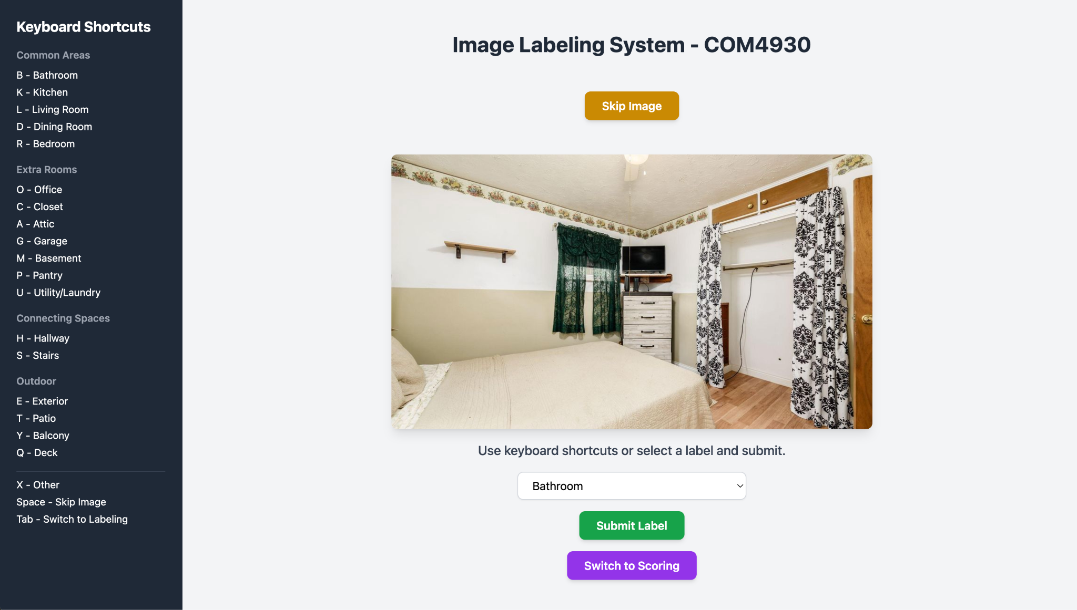
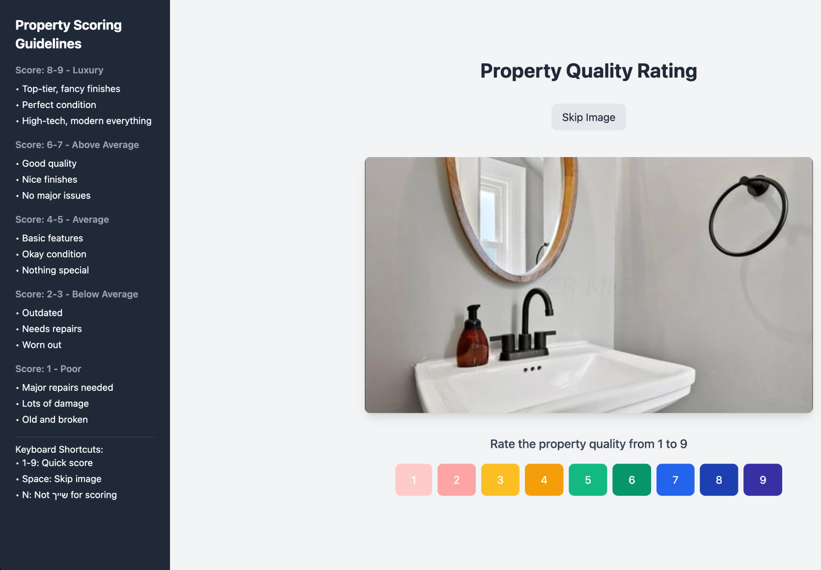
Data Collection: Labeling and Scoring
Explain
Demo

Slide 6
CNN
ResNet18-Based Room Classifier (11,181,642 parameters)
Task: Multi-class classification (predict room type among 10 categories).
Architecture:
Pretrained ResNet18
Final fully connected (FC) layer replaced with nn.Linear(in_features, num_classes=10).
Retains strong feature-extraction capacity from ImageNet pretraining.
Loss Function:
nn.CrossEntropyLoss for multi-class classification.
Optimizer & Scheduler:
Adam optimizer with a learning rate of 0.001.
ReduceLROnPlateau scheduler to adjust learning rate when loss plateaus.
MobileNetV2-Based Score Regressor (2,305,921 parameters)
Task: Regression (predict a continuous “score”).
Architecture:
Pretrained MobileNetV2 (smaller version of ImageNet, training was taking too long).
Final classifier replaced with a small FC “head”:
nn.Dropout(0.2) > nn.Linear(...) > nn.ReLU() > nn.Dropout(0.2) > nn.Linear(..., 1)
Lightweight and efficient, suitable for large-scale or MPS (Metal Performance Shaders) usage.
Loss Function:
nn.MSELoss for regression tasks.
Optimizer:
Adam optimizer with a learning rate of 0.001.

Slide 7

Label CNN Demo

Slide 8
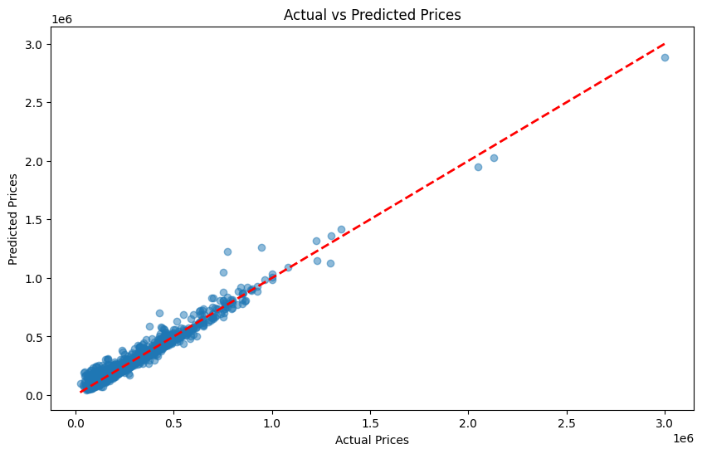
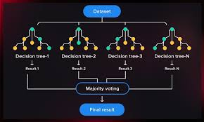
Price Prediction Model
Linear Regression
Finds linear relationships between features and price
Decision Tree
Partitions data into regions based on feature values and averages price within those regions
Random Forest
Creates multiple decision trees and averages them, being less sensitive to overfitting
Gradient Boosting (XGBoost)
Error correction on top of random forest, and can handle complex relationships and interactions in the data.

Slide 9
Results
Data incorporated | MAE | RMSE | SMAPE | R²
Only elementary data | $50,931 | $82,732 | 18.73% | 86.50%
With Zestimate | $30,183 | $52,946 | 12.71% | 94.47%
With image scores | $29,647 | $52,171 | 12.74% | 94.63%
Zestimate accuracy | $34,910 | $61,141 | 14.32% | 93.28%
Data used for all stages: bathrooms, bedrooms, living area, lot size, tax assessed value, yearBuilt
Trained on 5441 properties; tested on 1361.

Slide 10
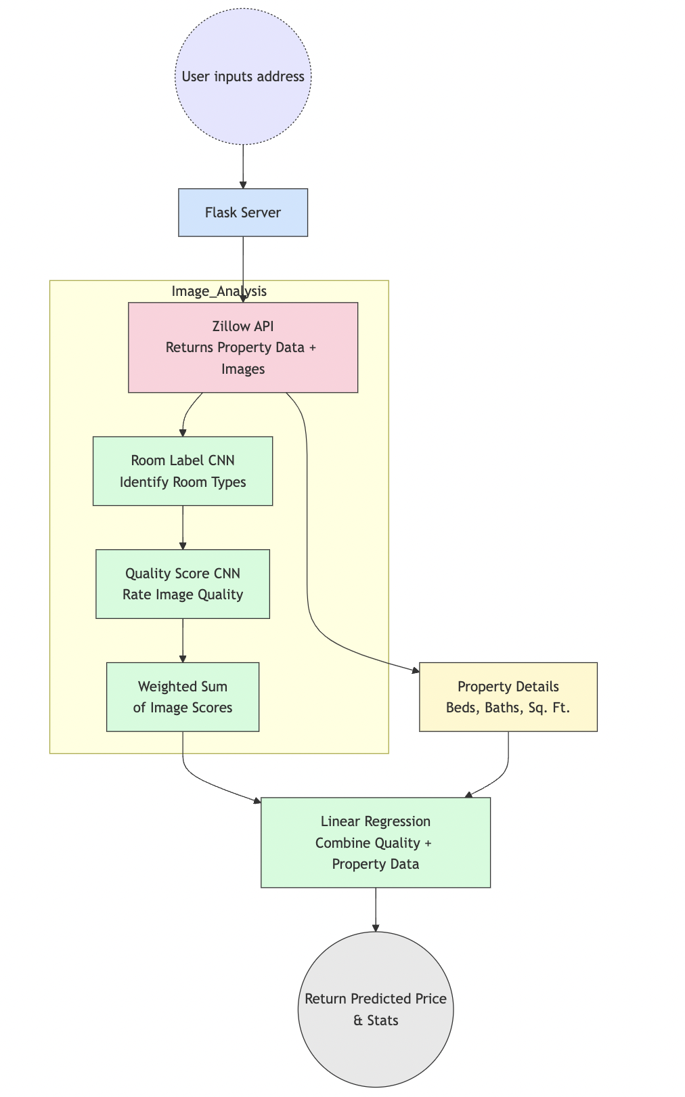
Putting It All Together
User Input: The user enters a property address.
Data Retrieval: A Flask server queries the Zillow API to fetch property details (e.g., beds, baths, square footage) and corresponding image URLs.
Room Classification: Each image is passed through a Room Label CNN to identify the type of room (kitchen, bedroom, etc.).
Image Quality Scoring: The images are then fed into a Quality Score CNN, which assigns a quality rating based on visual and aesthetic criteria.
House Quality Score: The individual image scores are combined (weighted sum) into an overall “house quality” metric.
Price Prediction: A Linear Regression model uses both the property’s features (e.g., size, location) and the house quality score to estimate the final home value.
Results: The predicted price, along with relevant statistics, is sent back to the user interface.

Slide 11
Demo

Slide 12
Future Improvements
Crowdsourced Quality Scores Gather user-based ratings from many more properties to refine the Quality Score. A larger dataset would improve both accuracy and confidence in the predicted price.
Geolocation & Comps Incorporate geospatial data to identify recently sold homes nearby. Comparable Sales (Comps) data can be automatically fed into the model to better reflect local market conditions.
Economic Indicators Pull in macroeconomic data (e.g., interest rates, GDP trends) so the model can adjust dynamically for broader market shifts—a key lesson from Zillow’s 2021 iBuying challenges.
Model Fine-Tuning Experiment with different weights for room scores and hyperparameters (e.g., learning rates, number of layers) to further optimize accuracy and reliability.

Slide 13








Technologies

